Slide 1


HOTEL AGGREGATOR ANALYSIS
MENTORNESS INTERNSHIP
TASK3: TABLEAU VISUALIZATION
BATCH NAME: MIP-DA-07

Slide 2
TABLE OF CONTENTS
01
Problem Statement
02
Project Objectives
03
Key Insights
04
Recommendations

Slide 3
PROBLEM STATEMENT
This project aims to analyze a dataset of hotel aggregator listings using Tableau/Power BI. The dataset comprises various attributes related to listings, hosts, reviews, and availability. The objective is to create comprehensive visualizations and insights that shed light on trends, patterns, and factors influencing the performance of listings.

Slide 4
PROJECT OBJECTIEVE
Geographical Insights: Visualize the distribution of listings on a map to identify popular neighbourhoods.
Pricing and Availability Analysis: Analyze pricing trends based on property types, room types, and accommodation capacity.
Host Performance: Evaluate host characteristics, including super host status, response times, and verification methods.
Review Scores and Guest Satisfaction: Examine review scores and their impact on overall listing performance.
Property Type and Room Analysis: Analyze the distribution of property types and room types.

Slide 5
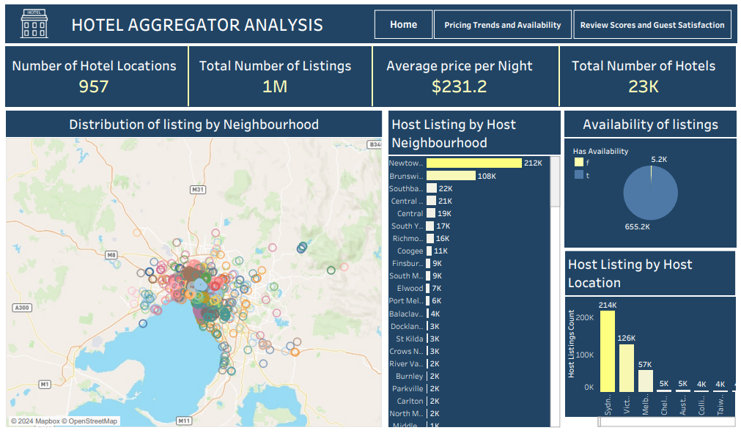
KEY INSIGHTS

Slide 6
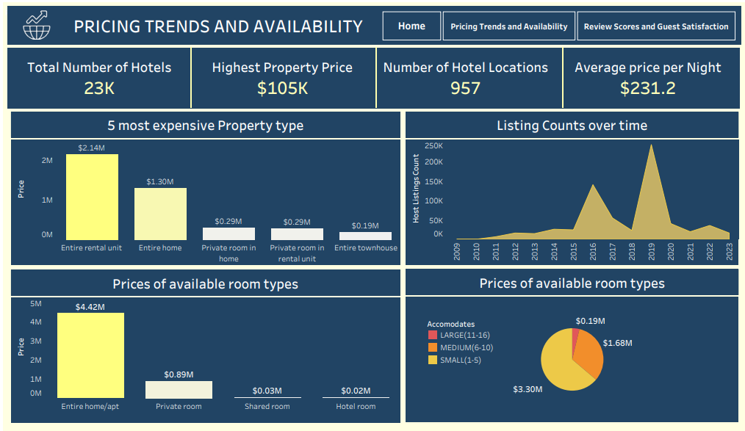
KEY INSIGHTS

Slide 7
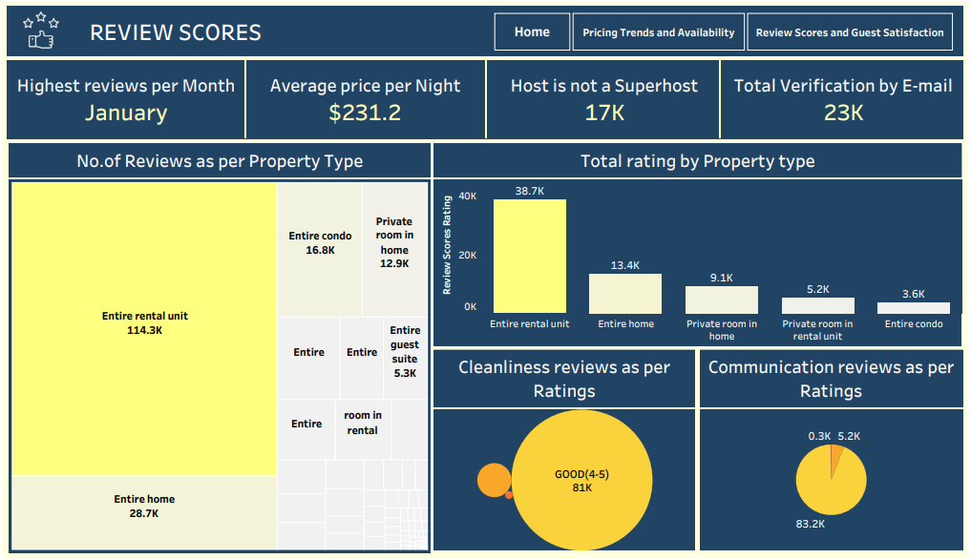
KEY INSIGHTS

Slide 8
KEY INSIGHTS
Geographical insights: Provides insights into the distribution of listings in popular neighbourhoods, host locations, and host neighbourhoods. It shows where properties are concentrated, where hosts are based, and which areas are popular among hosts and guests.
Pricing & availability analysis: It showcases average prices for different property types, room types, and based on accommodates.
Host performance: Presents insights into host performance metrics such as host response time, host verification methods, and host status. By analyzing this data, one can understand the distribution of host response times, verification methods used by hosts, and the proportion of super hosts versus regular hosts.
Review scores & guest satisfaction: It displays the relationship between review scores and host listing counts, host total listings count by year, and review scores based on property and room types. This data helps in understanding guest satisfaction levels, trends in review scores over time, and the impact of property and room types on guest experiences.

Slide 9
RECOMMENDATIONS
Host Performance Optimization: Encourage hosts to respond quickly for guest satisfaction. Promote varied verification methods to build trust. Highlight benefits of super host status for credibility.
Pricing and Availability Strategies: Analyze property and room type pricing trends for competitive rates. Adjust based on capacity for revenue and occupancy optimization. Monitor availability to capitalize on demand peaks and adjust pricing accordingly.
Guest Satisfaction Enhancement: Improve review scores with exceptional service and amenities. Track satisfaction levels to identify improvement areas. Tailor property offerings to enhance guest satisfaction.
Property and Room Type Management: Optimize inventory by understanding property popularity. Diversify offerings based on demand. Use insights to refine marketing and target relevant segments.

Slide 10
THANK YOU!

